Slide 1
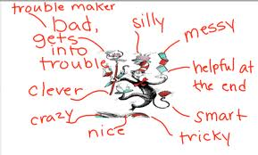
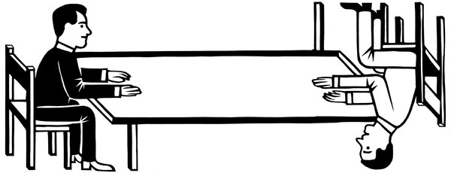
Comics – focus on learning
Comics and cartoons
How to describe characters
How to work with pictures

Slide 2

Lesson plan
Discussion
Duckurg
Glossary
History
Work in pairs/on your own

Slide 3
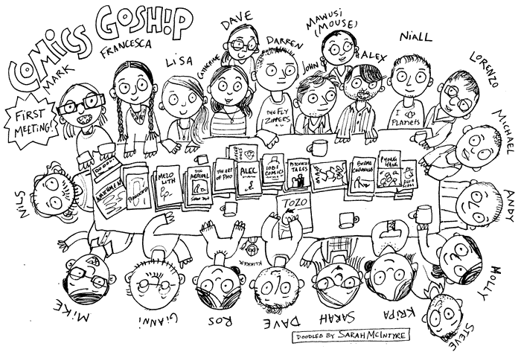
Discussion
You read comics, don’t you?
Many to choose from
Norway and comics

Slide 4
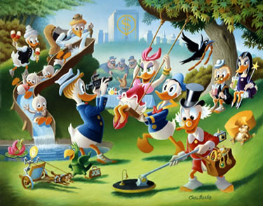
Duckurg and Norway
Donald Duck
140 000 copies sold every week
More than half a milion Norwegian, once or twice a weak read about life in Duckburg

Slide 5
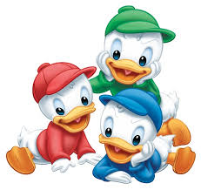
Huey, Dewey and Louie

Slide 6
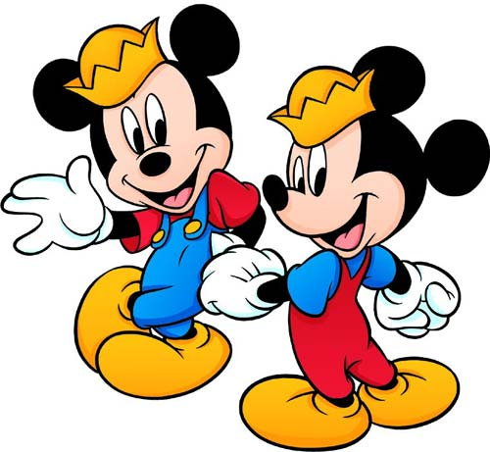
Morty and Ferdie

Slide 7
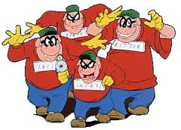
Beagle Boys

Slide 8
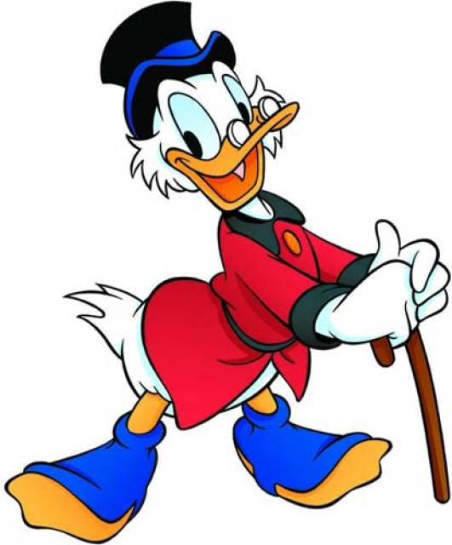
Uncle Scrooge

Slide 9
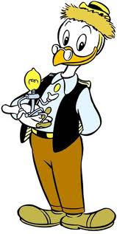
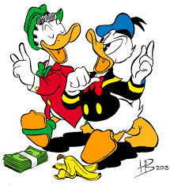
Gyro Gearloose,Gladstone Gander, Donald Duck

Slide 10
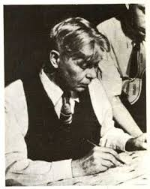
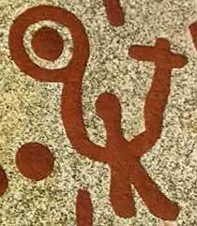
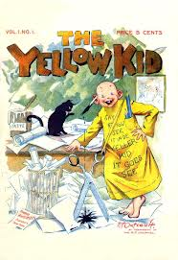


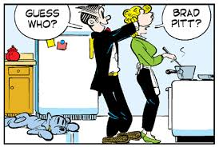
History

Slide 11
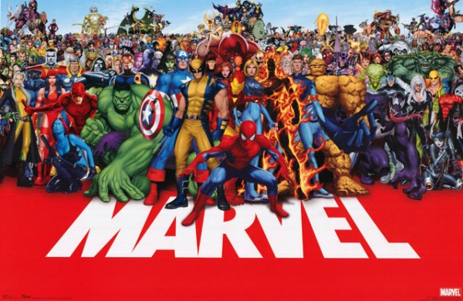

Slide 12


Slide 13
Pairwork
Which character is your favourite? Tell your partner what the character is like (but don’t mention the name), and ask him or her to guess who it is.
Make sure to use the question words
(who, what, when, which, why, where, whose, how)

Slide 14
Individual work – choose one
Do you like drawing?
  Make your own cartoon or comic strip and write a short text to go with your drawing(s).
  Perhaps the class can make its own comic book?
Do you read comics? Write a short text about why you read them or why you do not. If you read comics, say something about what kind you like to read and why.

